Slide 1
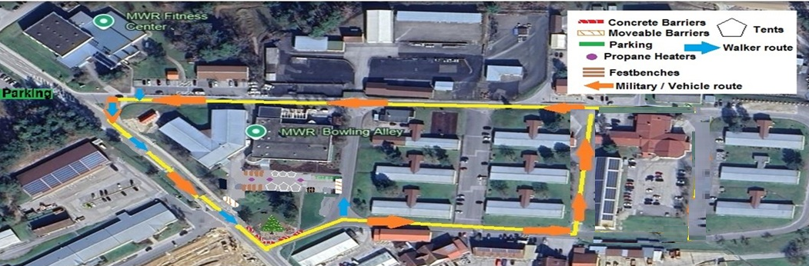

Hohenfels MWR Special Events
1. Only one live Santa will be permitted in the parade. (provided by MWR)
2. All entries must be suitably decorated including lights. (No open flame permitted)
3. If using a vehicle there must be 2 people (one on either side) to walk with vehicle, as a safety precaution for encroaching children.
4. No HANDOUTS whatsoever candy, toys, or written material NOTHING.
5. All entry forms must be received by 15:00 November 21st , 2025
THE FOLLOWING SAFETY RULES WILL BE STRICTLY ENFORCED.
Parade Route
A short trip beginning in front of the Sort Facility on Pershing Road heading past the ODR facility and then looping around in front of Rocket Park on General Patton Drive then heading up Lincoln St. back towards Pershing Rd. The whole parade is not much more than a few city blocks as we’re just wanting to light the way in for Santa for our special Tree Lighting Ceremony.

Slide 2
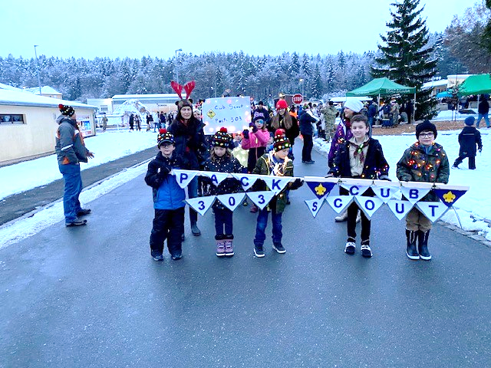
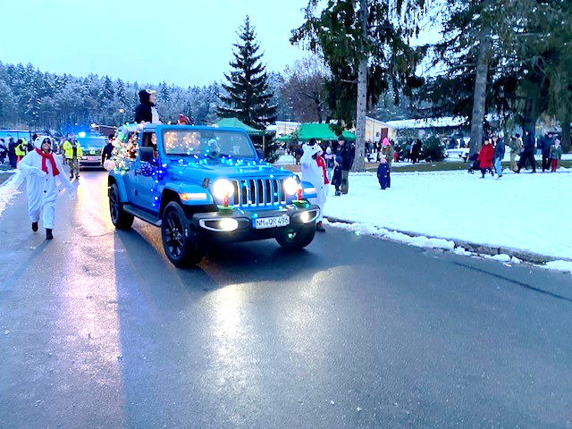
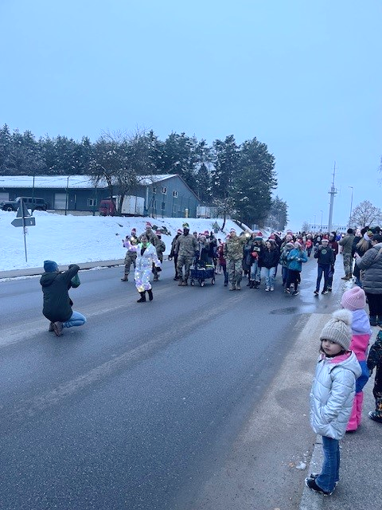
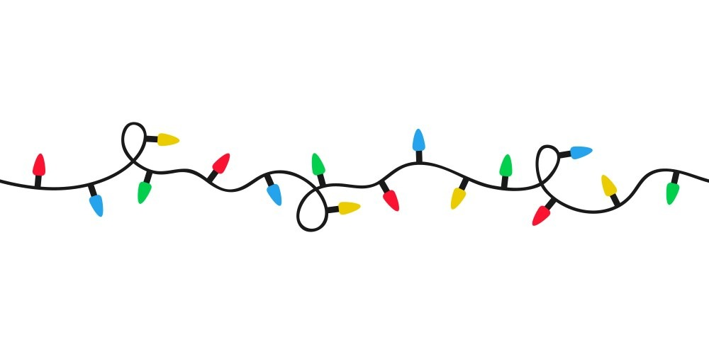
Contact Us
Parade Of Lights
Join us on Tuesday, 2 Dec 2025
Starting at 5:01 p.m.
The Holiday in Lights at USAG Bavaria Hohenfels is always a festive occasion. The community light parade, tree lighting by Santa, and the Christmas carols being sung are sure to bring lots of holiday cheer. Plus, with food, drinks, local crafters, and indoor activities for the kids, there’s something for everyone to enjoy. Don’t forget to get your photos with Santa! 🎅✨
Dec 2: 1701-1720
A Light Parade comin’ down the street
It’s sure to be a special treat.
Come out and join us
The best time of year!
Let’s Light the way
And spread some cheer.
MWR is looking for you to help light the way to the Annual Christmas Tree Lighting event. If you or your organization are interested in being part the annual Parade of Lights, then please contact us today!! There is no cost to participate, just light up your bike, stroller, wagon, or even just yours “elves” and light the way for Santa to the Hohenfels Annual Christmas Tree Lighting.
Roseann Saxton
DSN 522-1524
usarmy.hohenfels.imcom-fmwrc.list.webmaster@army.mil

